Slide 1
WEATHER FORECAST PREDICTION
Ashtageeta Hingmire | 50333659
Gouthaman Karthikeyan | 50327182
NehaGupta Devarasetty | 50327454
Rukmani Kalyanaraman | 50330048
Sujitha Rathinasabapathy | 50328956

Slide 2
TABLE OF CONTENT
2
CASE STUDY | 3
PROBLEM STATEMENT | 4
CHALLENGES | 5
SOLUTION | 6
4-STEP DIMENSION MODEL | 7
CONTROL FLOW | 8
ETL FOR DIMENSION TABLE | 9
ETL FOR FACT TABLE | 13
ERD | 15
DATA VISUALIZATION | 16
5 DAYS WEATHER FORECAST COMPARISON | 22
COMPARISON | 23
OUTCOMES/CONCLUSION | 24
ANALYTICAL TOOLS USED | 25

Slide 3

CASE STUDY
3
Project Scope
To predict weather forecasts(1-5 days) for consumers.
As you might expect, data and data analytics rule in generating weather forecast success.
The accuracy of weather forecasts depends on the quality and quantity of data that is available.
For temperature forecasts, AccuWeather was the most accurate for wind and precipitation forecasts and high-temperature forecasts.
While The Weather Channel was the most accurate for the low-temperature forecast.

Slide 4
Problem Statement
4
As a new intern of ForecastWatch, to design, implement and present from a sample data warehouse to show its model and applications to a media client in Dallas who want to use your data in the local TV news.

Slide 5
Challenges
5
Data Collection
To predict the weather is limited by three factors:
the amount of available data;
the time available to analyze it;
the complexity of weather events.
Data Cleaning
To clean unnecessary attributes that were not required for the model.
Converting Data Types to the desired Format.
Data Modeling
To create the correct ETLs
Data Prediction
To predict the correct formula for the future forecast.

Slide 6
Solution
6
Data Collection
After a rigorous search, we found data from
www.noaa.gov/weather
www.weather.gov
www.ncdc.noaa.gov/crn/
www.weather.gov
Data Cleaning
After careful consideration we eliminated a few attributes like snow depth, new snow
Converting DateKeyWSTR to DateKeyDT_I4 and DateKeyDT_DBSTMP.
Data Modeling
With utmost attention we decided to create
4 Dim Tables
2 Fact tables
Data Prediction
After Brainstorming a few ideas, our team came up with the idea of generating future weather for 5 days.

Slide 7
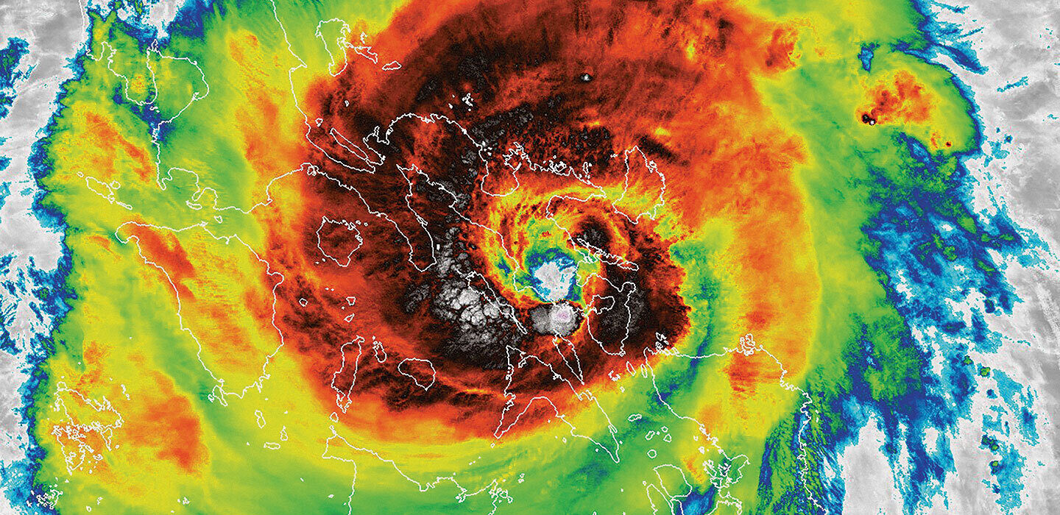
4-STEP DIMENSION
7
Our Data model includes attributes like:
EventID
StationKey
DateKey
TemperatureKey
WFO_Identifier
Location
Event_Type
Min
Max
Avg
HDD
CDD
Precipitation

Slide 8
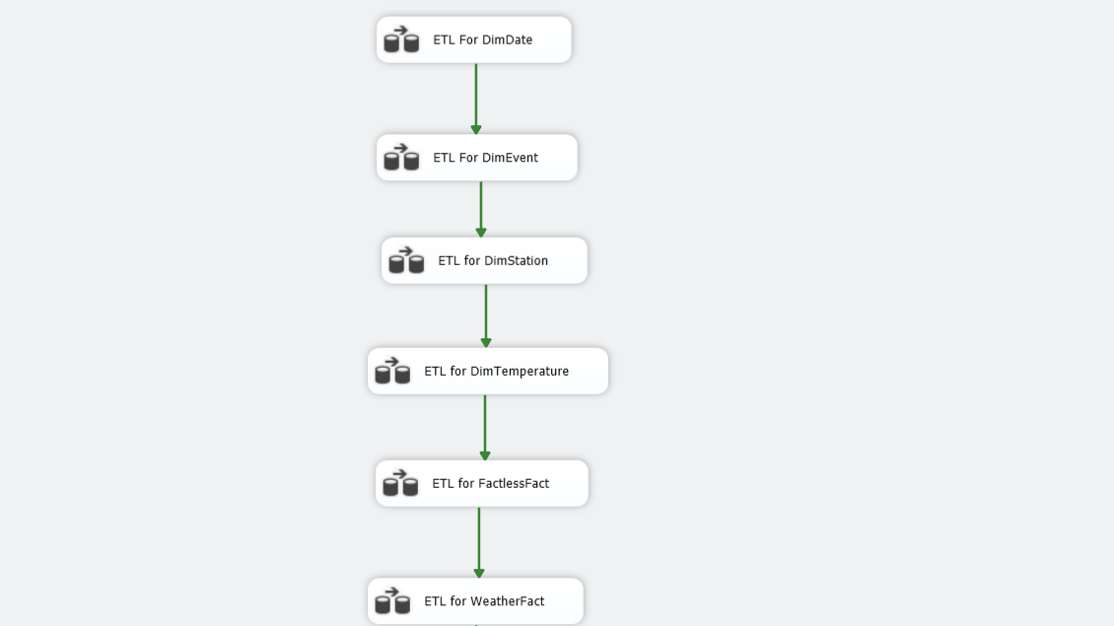
CONTROL FLOW
8

Slide 9
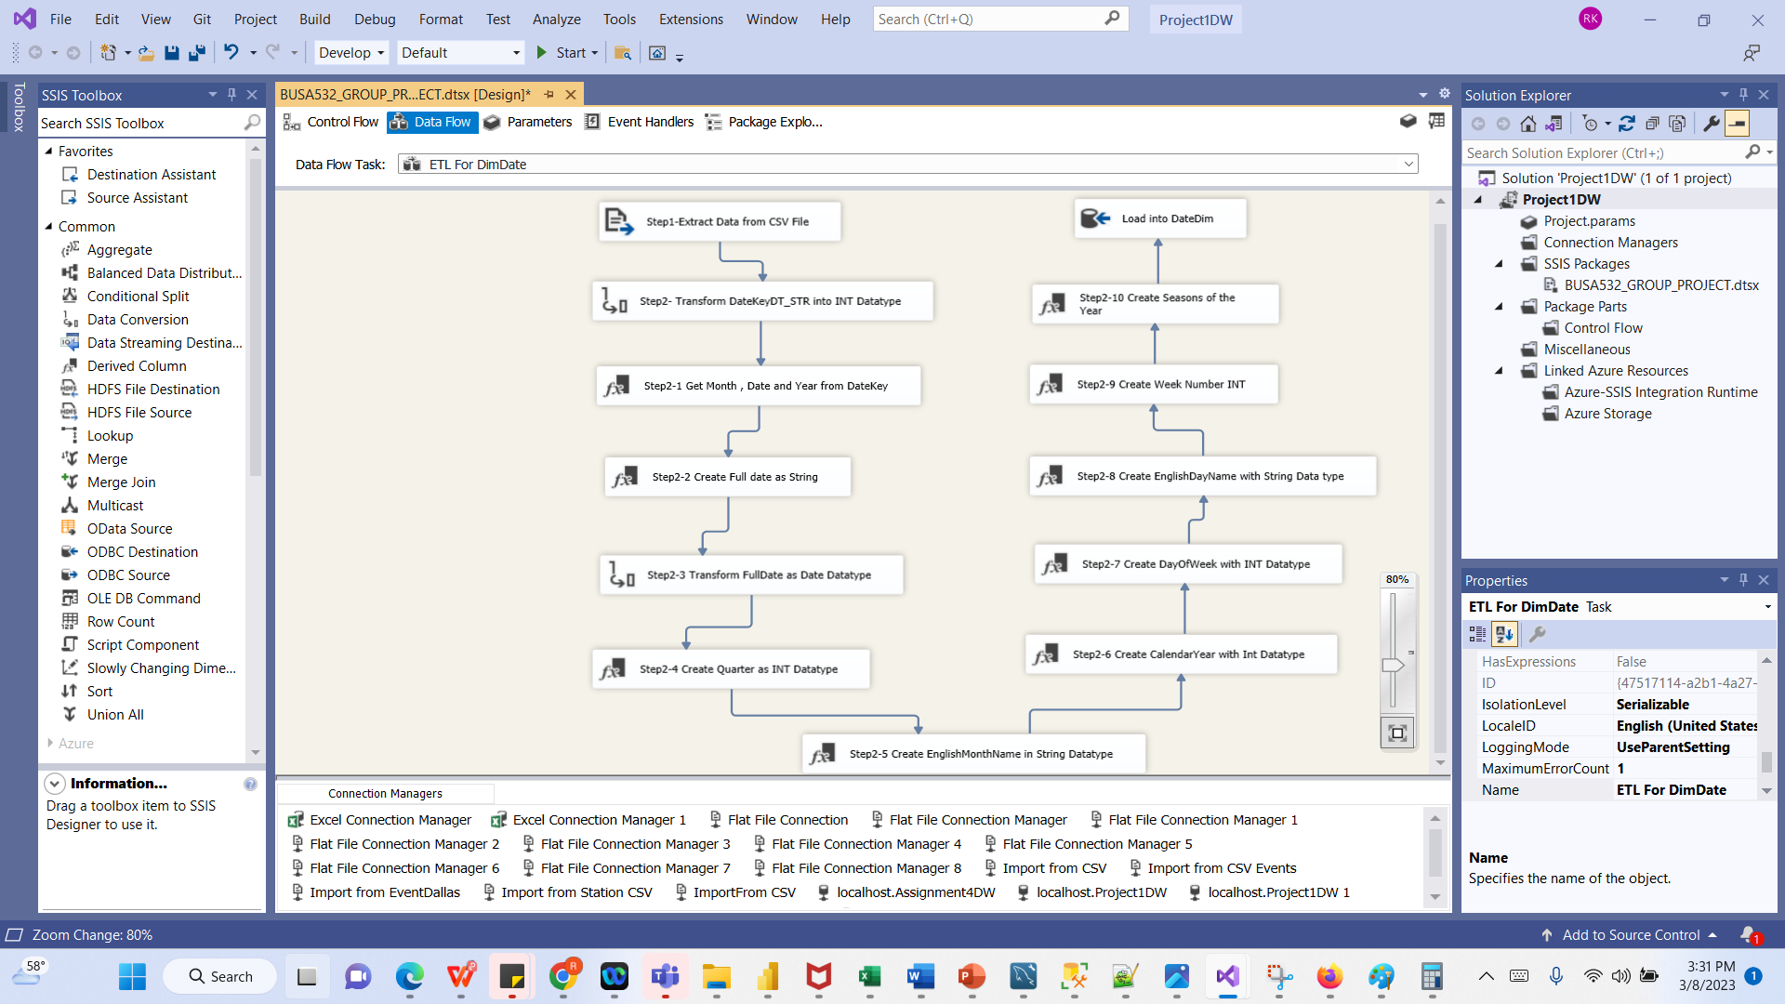
ETL FOR DimDate
9

Slide 10
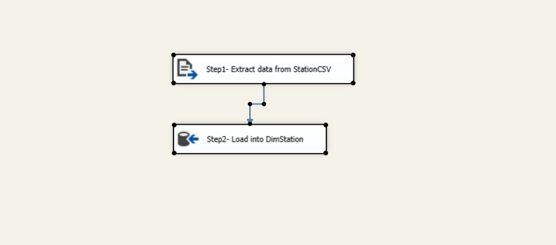
ETL DimStation
10

Slide 11
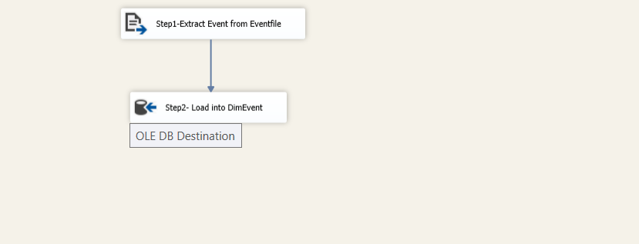
ETL for DimEvent
11

Slide 12
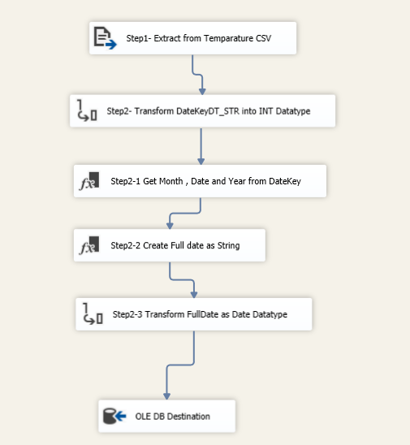
ETL for DimTemperature
12

Slide 13
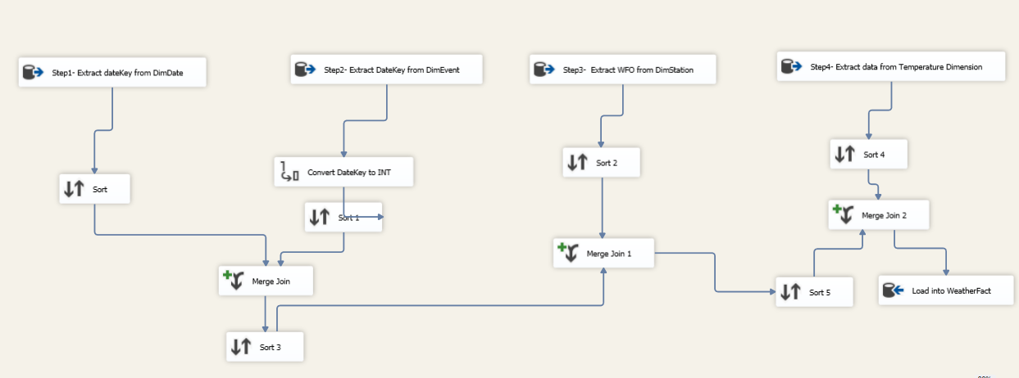
ETL for FactlessFact Table
13

Slide 14
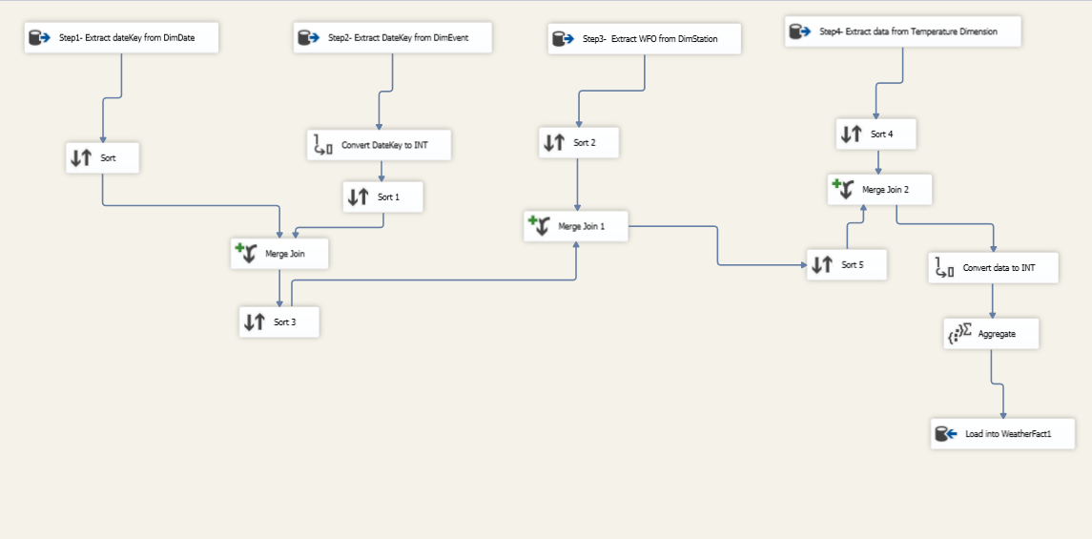
ETL For Fact Table
14

Slide 15
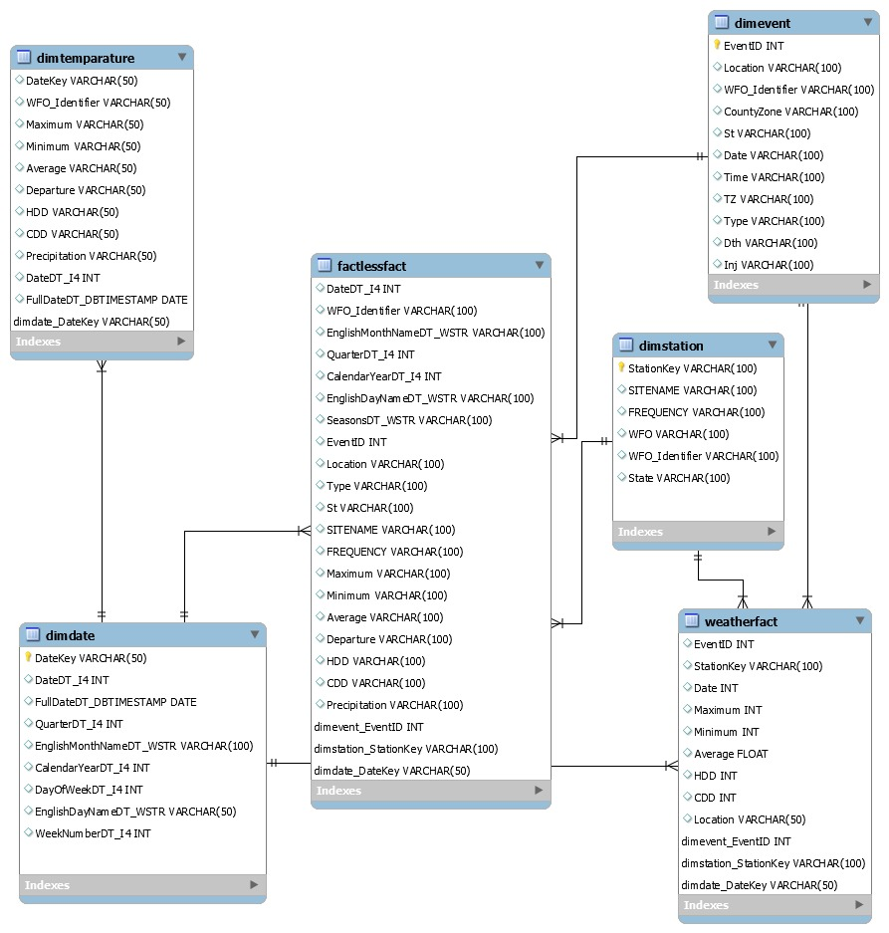
ERD
15

Slide 16
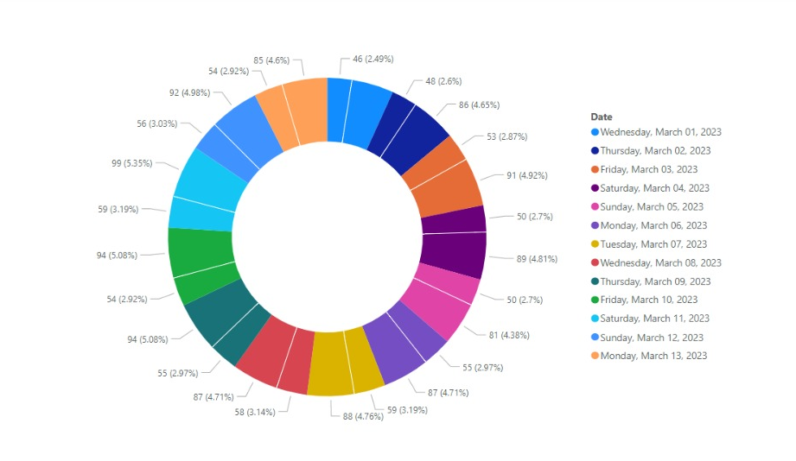
DATA VISUALIZATION
16

Slide 17
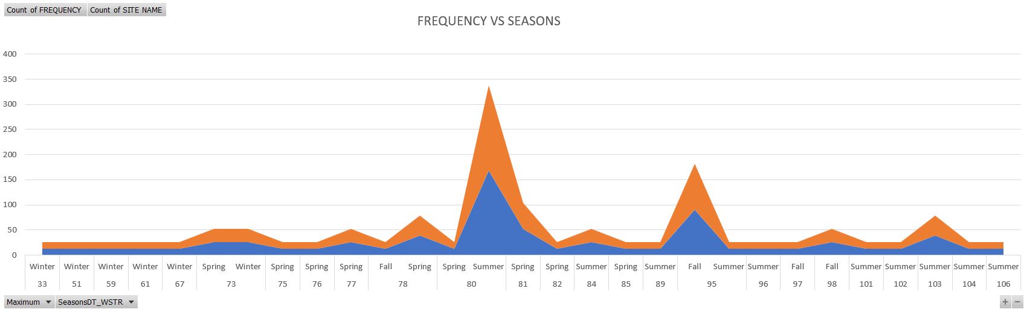
FREQUENCY VS SEASONS WITH RESPECT TO SITE
17

Slide 18
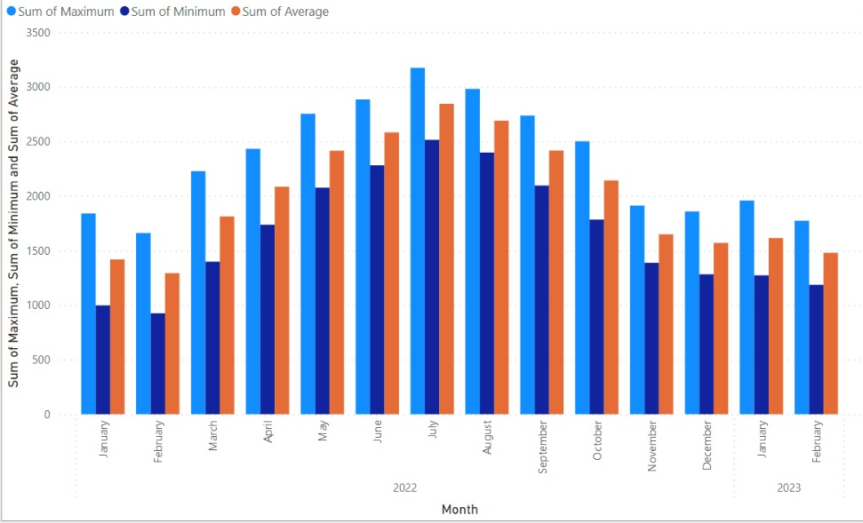
MONTHLY TEMPERATURE DATA
18

Slide 19
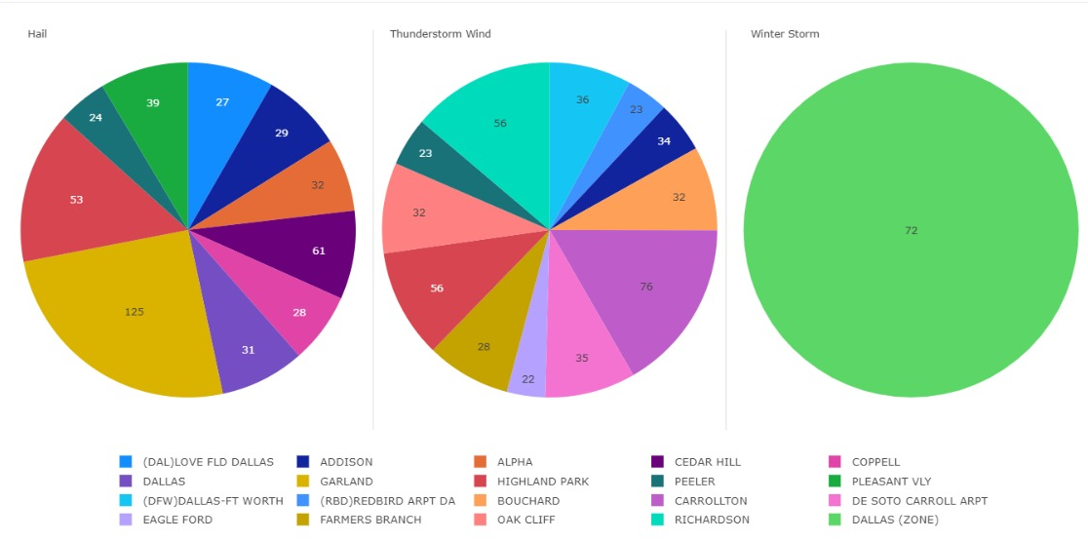
EVENTS BY LOCATION
19

Slide 20
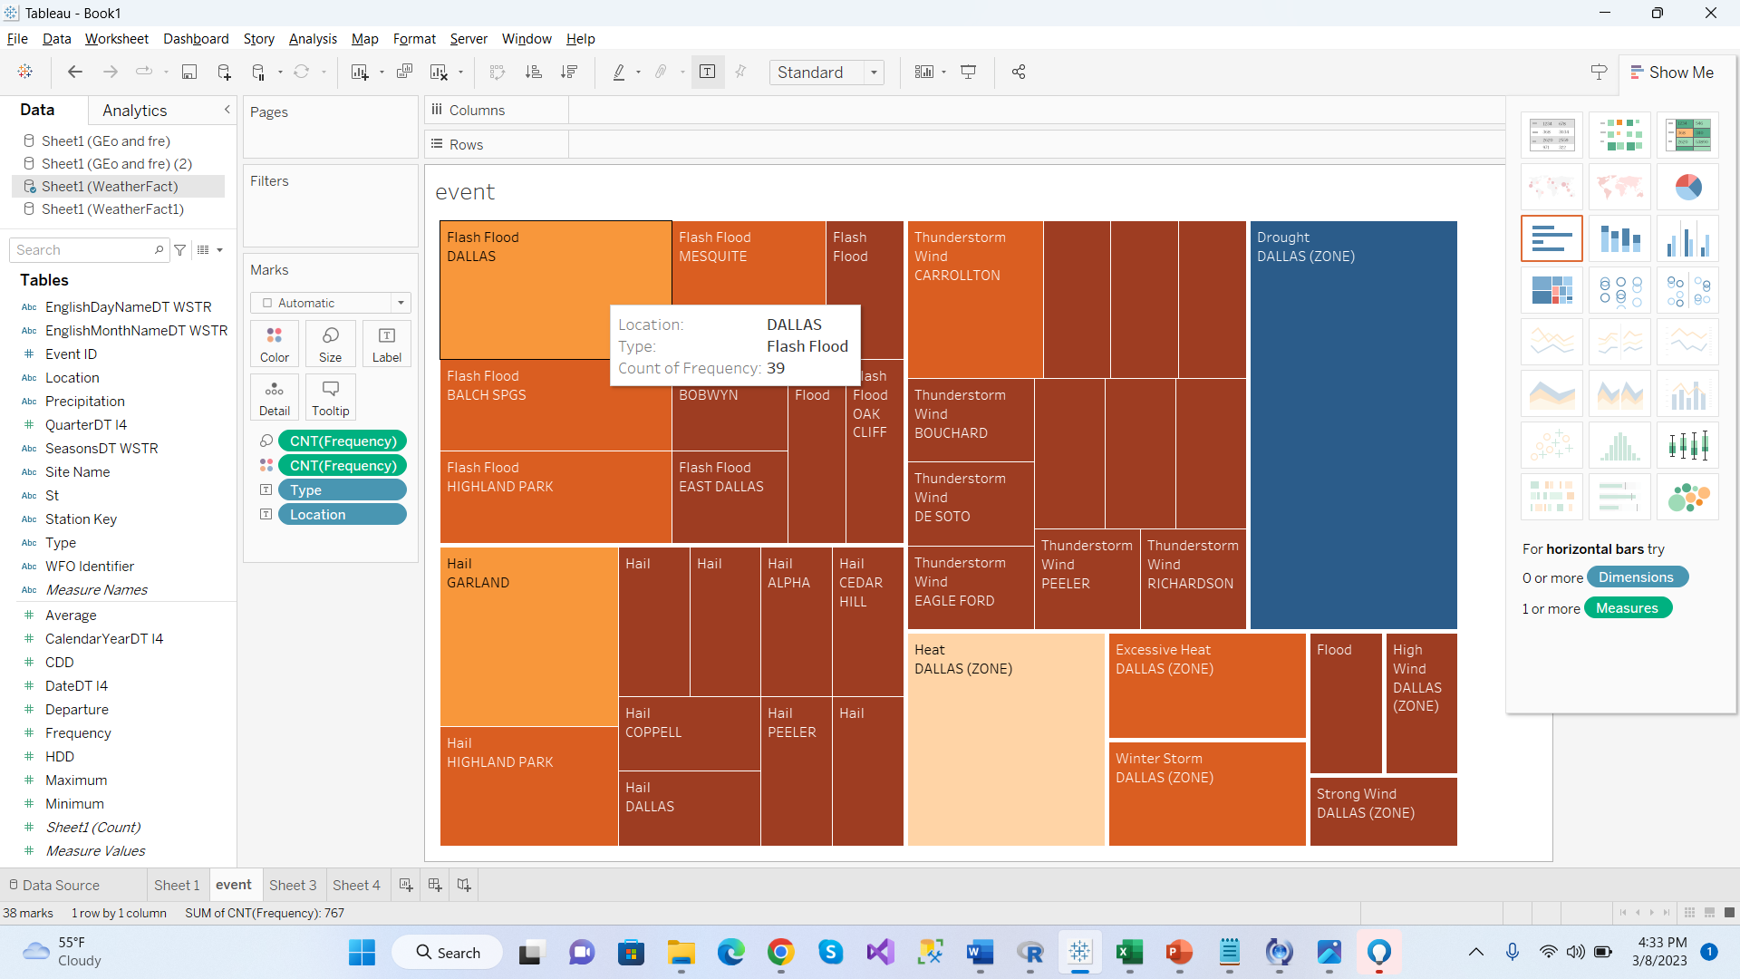
EVENT FREQUENCY BY LOCATION
20

Slide 21
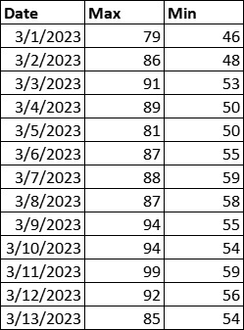
WEATHER MAP
21
DALLAS

Slide 22
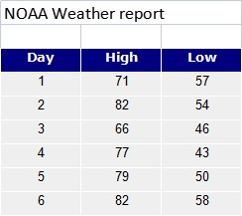
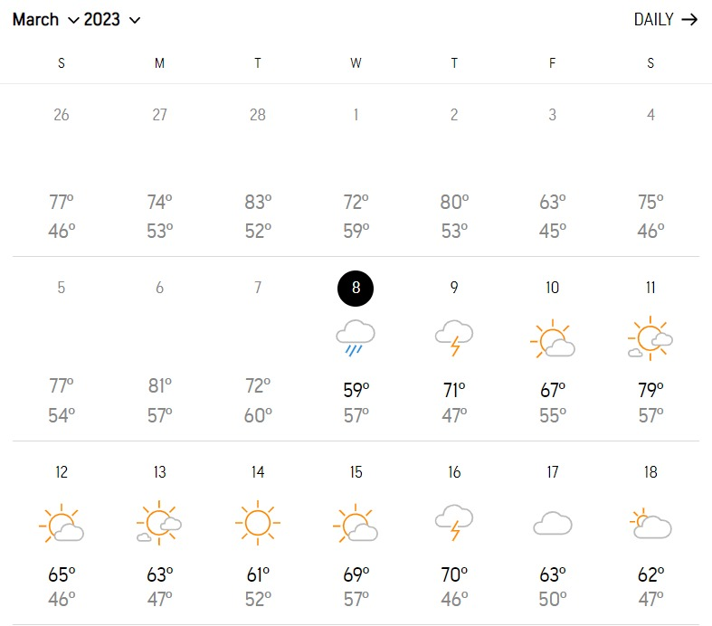
5 DAYS WEATHER FORECAST COMPARISON
22
ForecastWatch
NOAA
Accuweather

Slide 23
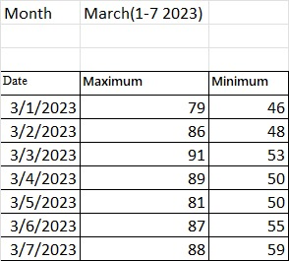
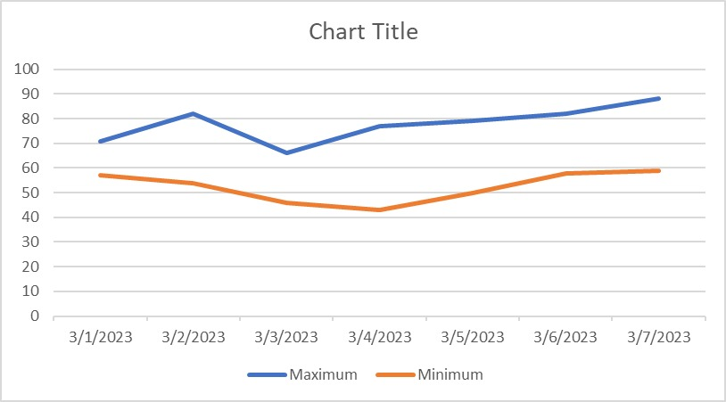
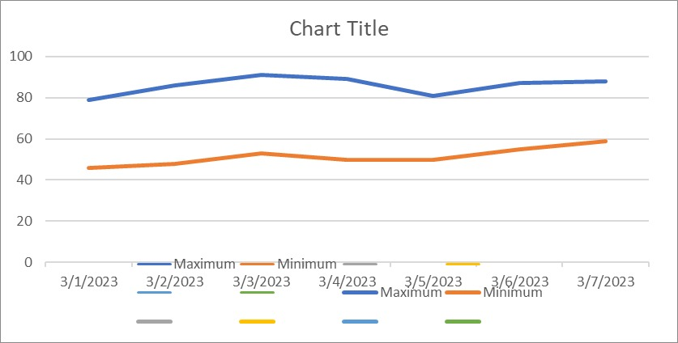
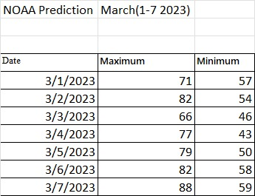
COMPARISON
Comp 1
Comp 4
Comp 2
Comp 3
23

Slide 24
Outcomes
24
Our predicted weather forecast value is
52 % matching with NOAA.
68% matching with ACCU weather

Slide 25
ANALYTICAL TOOLS USED
25
VISUAL STUDIO 2019
MICROSOFT SSMS
POWERBI
TABLEAU
MICROSOFT EXCEL
MYSQL

Slide 26
THANK YOU
1

